Slide 1


Introduction to Managing Risk
Waikato Community Transport Forum
March 2024

Slide 2


‘The major risk for most organisations is that they could fail to achieve their objectives and thereby lose the trust of their stakeholders’
Standards NZ – Guide to managing risk in the not-for-profit sector
STEWARDSHIP:
“Careful and responsible management of something entrusted to one’s care”
Strategic direction and purpose
Managing risk

Slide 3


Slide 4
Risk Management Framework
Start by establishing the context - Purpose and Objectives, Stakeholders, External influences, Internal influences
Establish the context
Identify the risks
Analyse the risks
Evaluate the risks
Treat the risks
Communicate and Consult
Risk Assessment
Monitor and Review

Slide 5
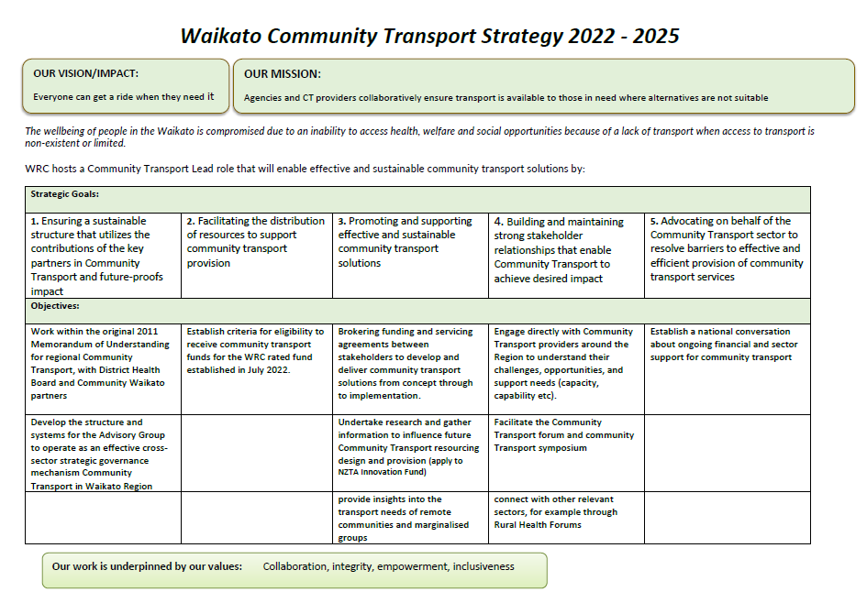

Slide 6
Financial Sustainability (income, control and expenditure) Safety and well-being of its people and those it engages with Reputation and brand | Legal and regulatory compliance Quality service delivery

Slide 7
Financial Sustainability (income, control and expenditure) Having more than one major source of income Safety and well-being of its people and those it engages with Being a good employer – always acting in good faith Reputation and brand Being well known in our community | Legal and regulatory compliance Knowing and meeting all legal and regulatory compliance Quality service delivery Providing what the people we serve want

Slide 8

At your table, brainstorm all the risks to your organisations that you can think of.

Slide 9
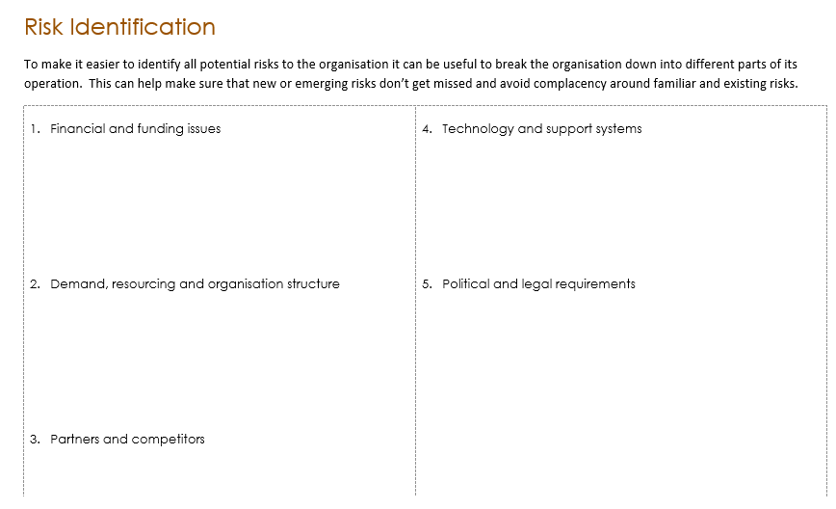


Slide 10

Common strategies for minimizing risk
Avoiding the risk
Removing the source of the risk
Changing the likelihood
Changing the consequences
Sharing the risk with another party or parties
Retaining the risk by informed decision
Transferring the risk

Slide 11

An Overview of Risk Management
Communicate and Consult
Who do we need to consider and include? What is their interest? How shall we involve them?
What does success look like?
Risk
Assessment
Establish
the context
Identify
the risks
Analyse
the risks
Evaluate
the risks
Treat
the risks
Consider:
Financial sustainability
Well-being and safety of people
Reputation and brand
Legal and regulatory compliance
Quality service delivery
Consider:
What is our purpose and our objectives?
Who are our stakeholders and what are their expectations?
What internal influences could cause uncertainty?
What are the external influences could cause uncertainty?
Think about:
What might happen? How, when and why?
Financial and funding issues
Demand, resourcing and organisation structure
Partners and competitors
Technology and support systems
Political and legal requirements
Consider:
What will this mean to our objectives?
What would the impact be?
Consider:
What is the likelihood/ probability of something happening?
What would the impact/ consequence be if it did happen?
Develop a risk register to record the risks requiring attention
Acting to:
Avoid the risk
Remove the source of the risk
Change the consequence
Share or transfer the risk
Retain the risk in an informed manner
Monitor and Review
Have the risks and controls changed? Is our policy working? Are we adhering to our policy and procedures?
Contributing information from Standards New Zealand – Guide to managing risk in not-for-profit organisations; Running the Risk? Risk Management Tool for Volunteer Involving Organisations – Volunteering Australia

